Slide 1
COMMUNICATION COMPASS
with Dr. Stevie Dawn Carter

Slide 2
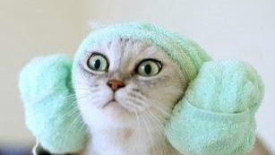

Slide 3
IT DOESN'T MATTER WHAT YOU SAY.
IT ONLY MATTERS WHAT THEY HEAR.

Slide 4
WHAT DO WE REALLY HEAR?
Face to Face : 5 out of 7 words
Over the Phone : 4 out of 7 words
On a Zoom : 4 out of 7 words
Reading Email : 3 out of 7 words
In a Group : 3 out of 7 words

Slide 5
THE COMMUNICATION COMPASS
A speech pattern recognition tool to assist you in speaking in the same language as the other person.

Slide 7
CONSIDERATIONS
What is your preferred style?
What style is the hardest to adapt to?
Which style do you need to improve upon?
How do you see these styles at work?
How do you see these styles at home?
How can you use this knowledge to improve your conversations?

Slide 8
SYMPATHY VS. EMPATHY
Unique experiences
Unemotional understanding and acceptance
Focus on listening before acting.
Looking to vent? Looking to help?

Slide 9
Compassion Fatigue
Practice Self-Care
Set Emotional Boundaries
Engage in Hobbies
Cultivate Friendships outside of Work
Journal/Meditate
Focus on Resiliency/Joy
Take Breaks

Slide 10
IT DOESN'T MATTER WHAT YOU SAY.
IT ONLY MATTERS WHAT THEY HEAR.

Slide 11
THANK YOU
stevie@steviedawninspires.com
817-913-3337
www.drsteviedawn.com

